Slide 1
Final Project Presentation
106753038 張筆翔
107753042 朱奕寧

Slide 2
Taipei House Rental 2018
Data
Goal
Modeling
Demo

Slide 3
1
Data

Slide 4

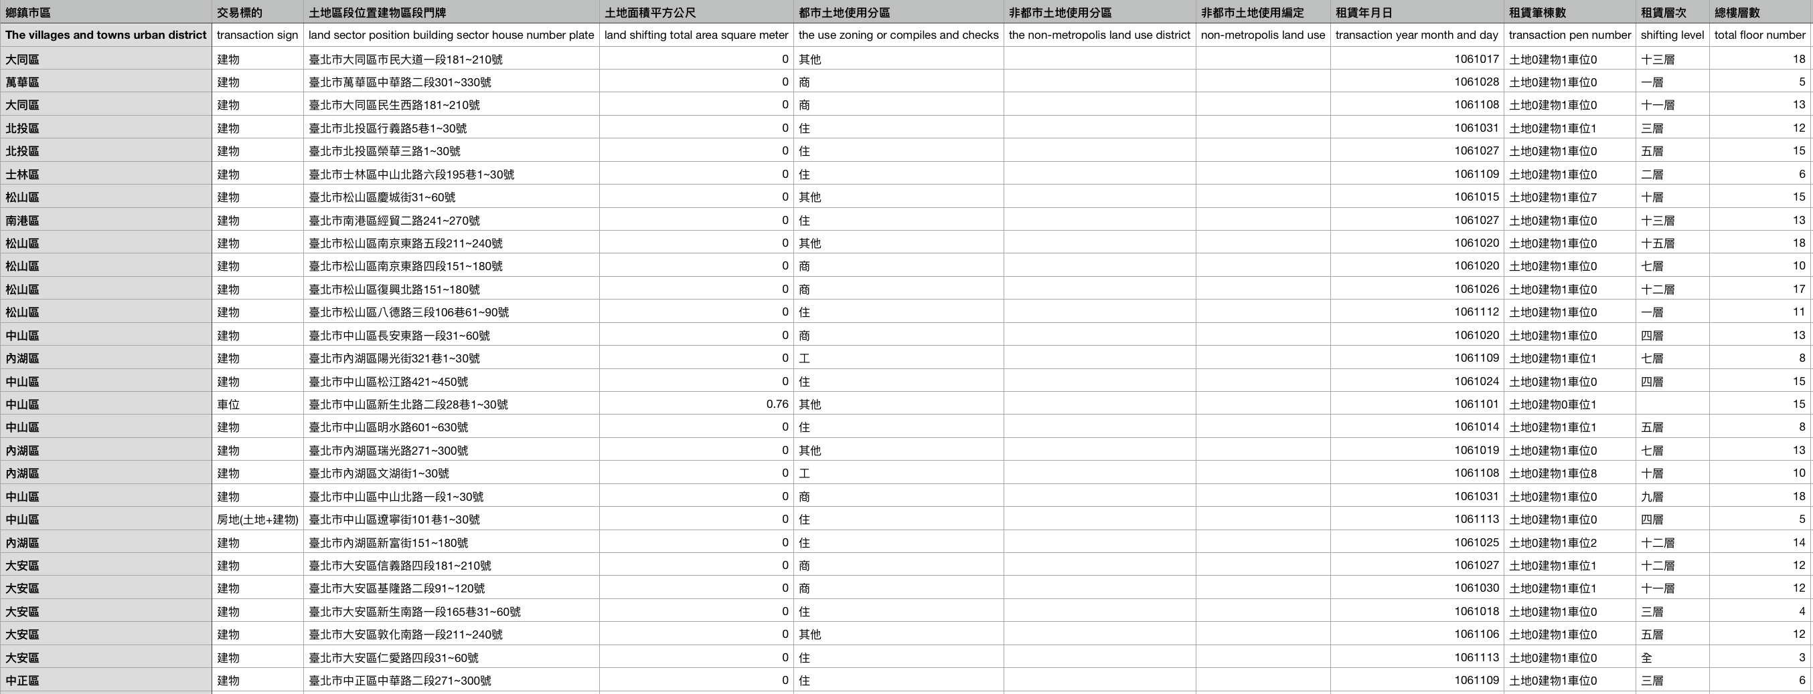
Data Source
Dept of Land Administration M. O. I.
( https://lvr.land.moi.gov.tw/homePage.action )
Data Content
Region, Address, Size, Date …

Slide 5
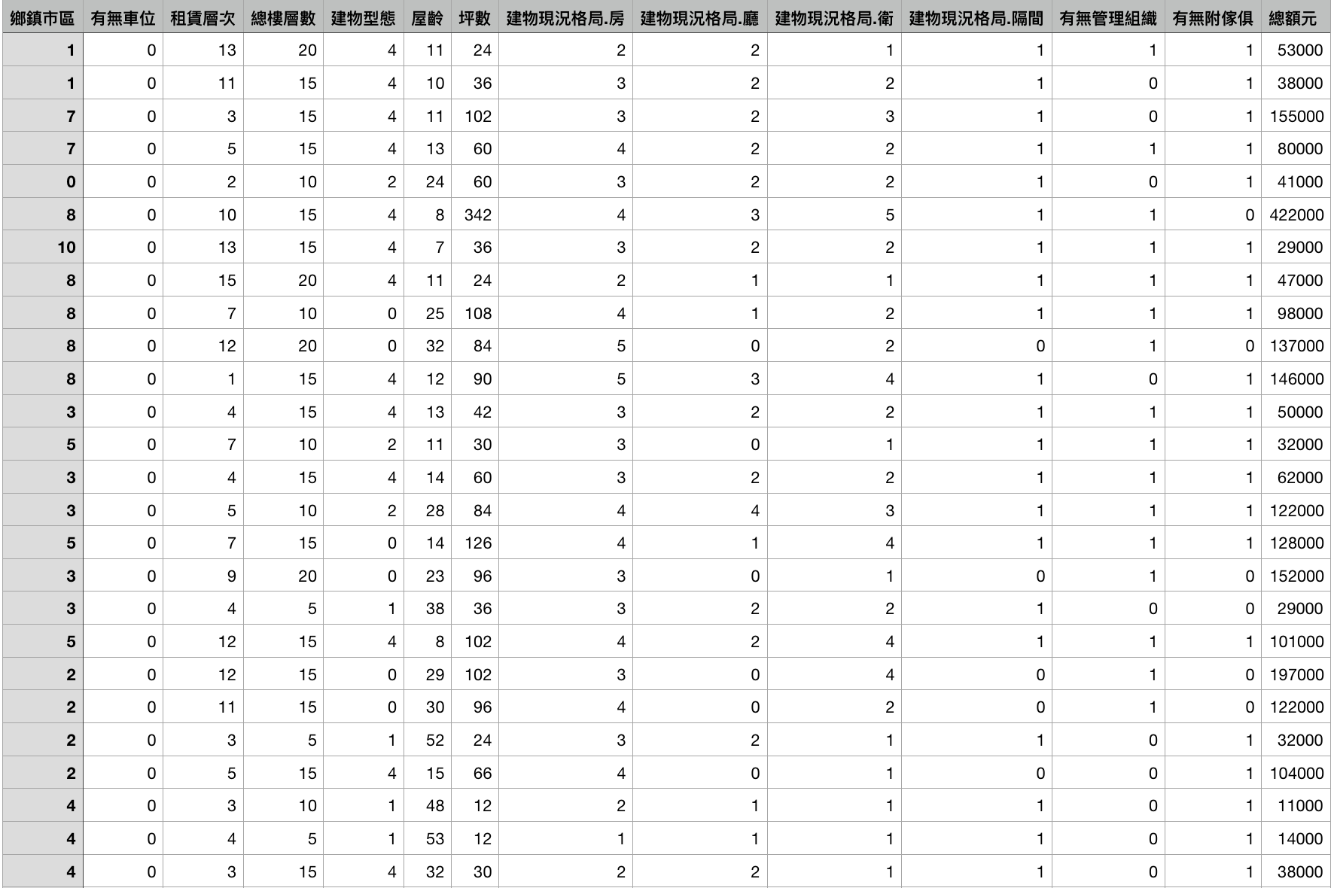
Modifying value
Region
Parking lot
Rental Floor
Total Floor
Years
Size
Rooms/Halls/Bathrooms
Administrator
Furniture

Slide 6
2
Modeling

Slide 7

RandomForest
Perform 5-fold cross-validation
Testing Accuracy: 0.1584543
Training Accuracy: 0.9816459
Validation Accuracy: 0.81573

Slide 8
3
Goal

Slide 9
Data training
Searching for prediction data
Data processing

Slide 10
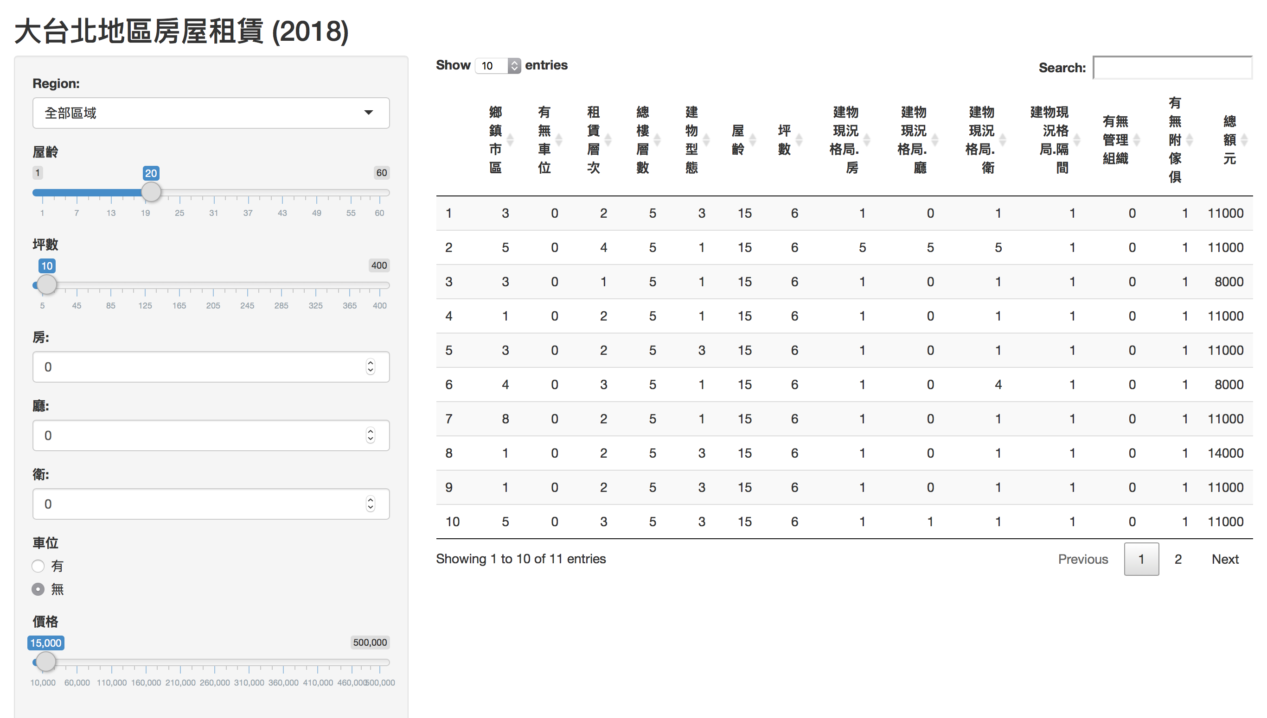
User Interface

Slide 11
4
Website

Slide 12
Website
https://ryuuuuuu.shinyapps.io/Taipei_House_Rental_2018/

Slide 13
END

